Slide 1
Design Specifications
VEL Team
21 Aug 2015

Slide 2
Content
Software Architecture and design
Architecture Diagram
Class Diagram
Design Considerations
Low Fi Prototypes
Page Workflow
Main Page
Successful Stories
Administration Tools

Slide 3
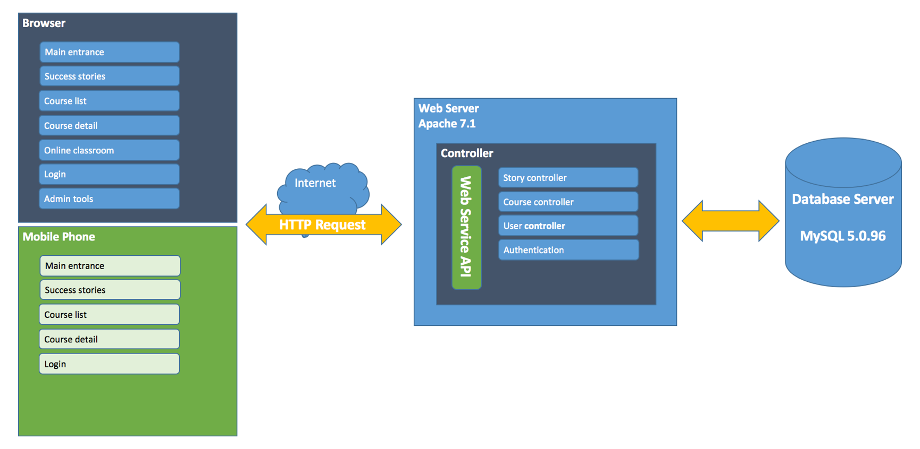
Architecture Diagram (1)

Slide 4
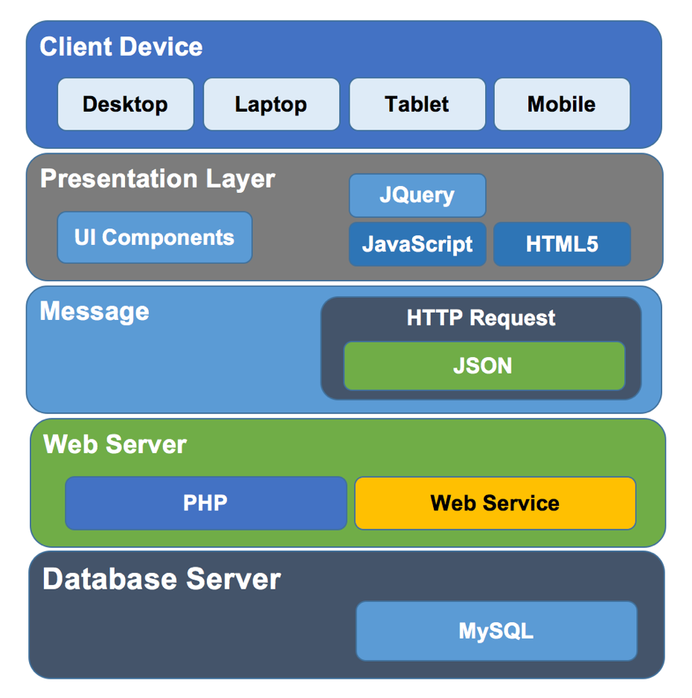
Architecture Diagram (2)

Slide 5
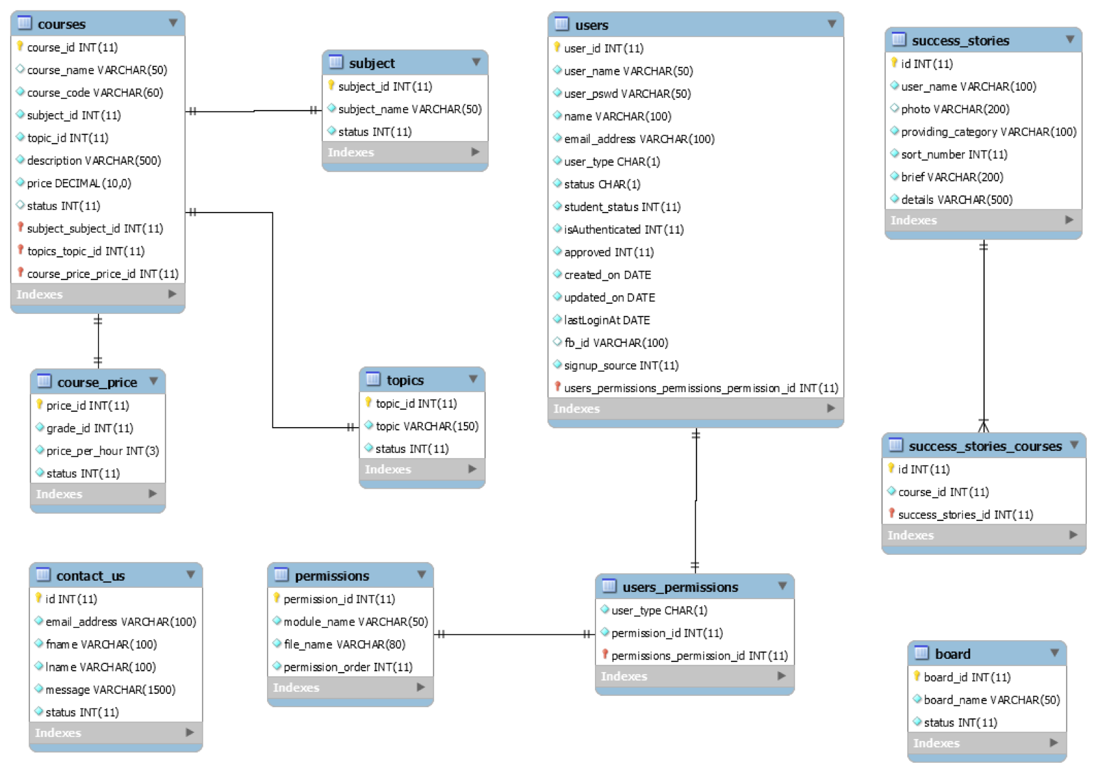
Class Diagram

Slide 6
Design Decisions (1)
Mobile-friendly
Starting April 21, 2015, Google Search will be expanding its use of mobile-friendliness as a ranking signal.
“Google mobile-friendly test tool”, test website on below criteria:
1) Links too close together
2) Text too small to read
3) Mobile viewport not set
4) Content wider than screen

Slide 7
Design Decisions (2)
Security
Getskills.co.nz website contains confidential business information from both their business partners and individual trainees. In this way, the website needs to be strictly security and private.
Maintainability
Their website should be able to renew information from different parties, such as new classes, new positions, and new promotions. The website should be maintainable. We decide the maintainable attributes in refined Getskills.co.nz websites will keep pace with the exist website.

Slide 8
Design Decisions (3)
Aesthetic property
The CEO has a higher expectation on the website layout designs. He emphases that, “industry need artists and designers to help connect our business with end customers and establish a trust in the brand.” Our team decide to re-beautify the current web pages. We will try to improve the current website page designs to make it more appealing. Relevant techniques involve CSS, JavaScript.

Slide 9
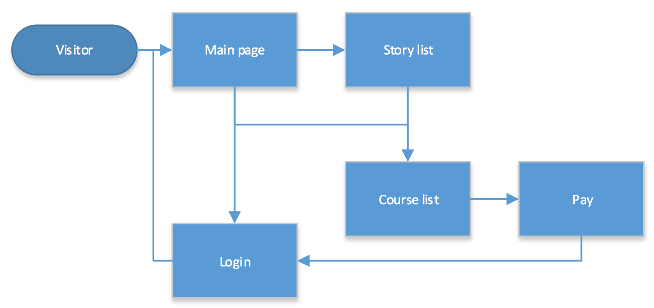
Low Fi Prototypes -visitor page workflow

Slide 10
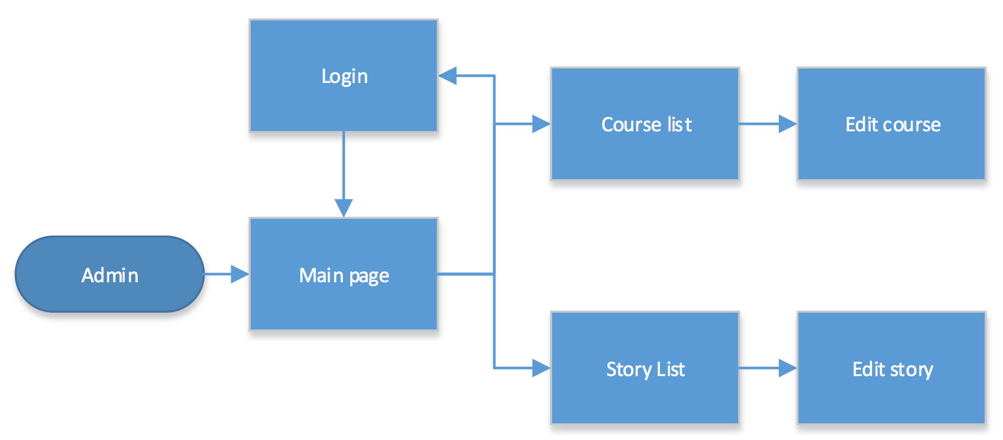
Low Fi Prototypes -admin page workflow

Slide 11
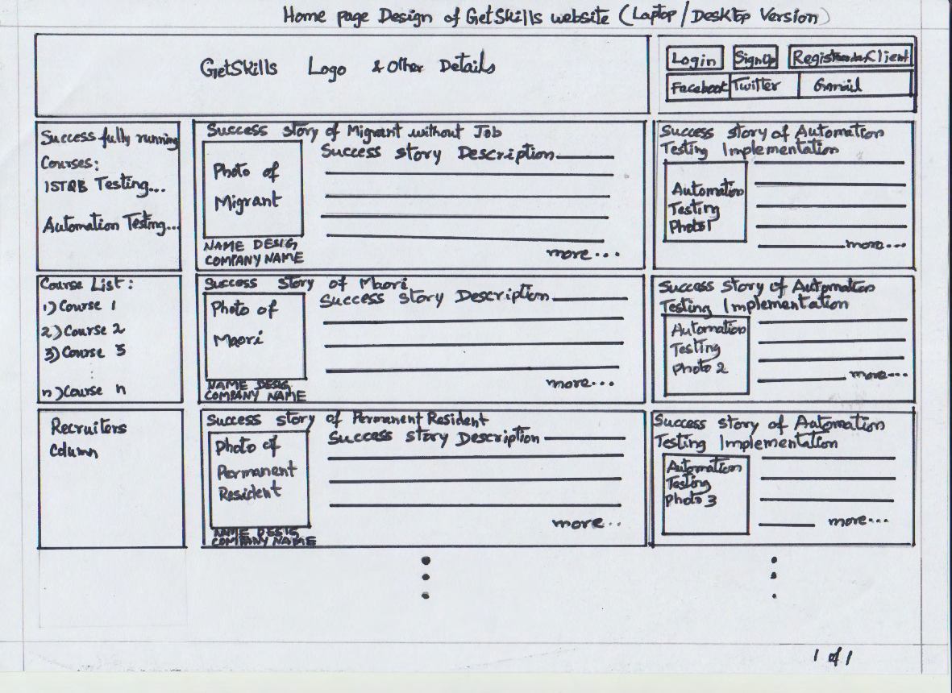
Main Page - desktop

Slide 12
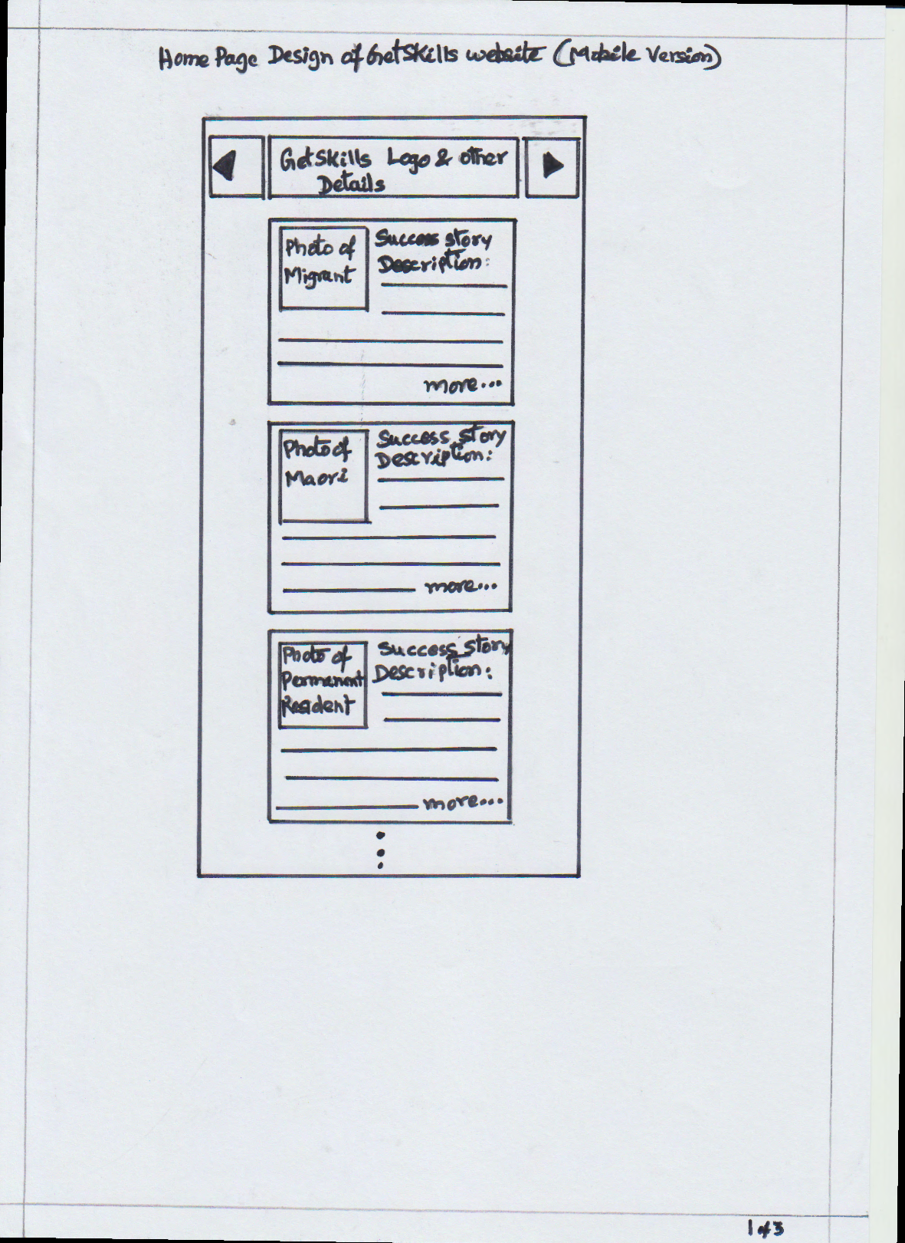
Main Page - mobile

Slide 13
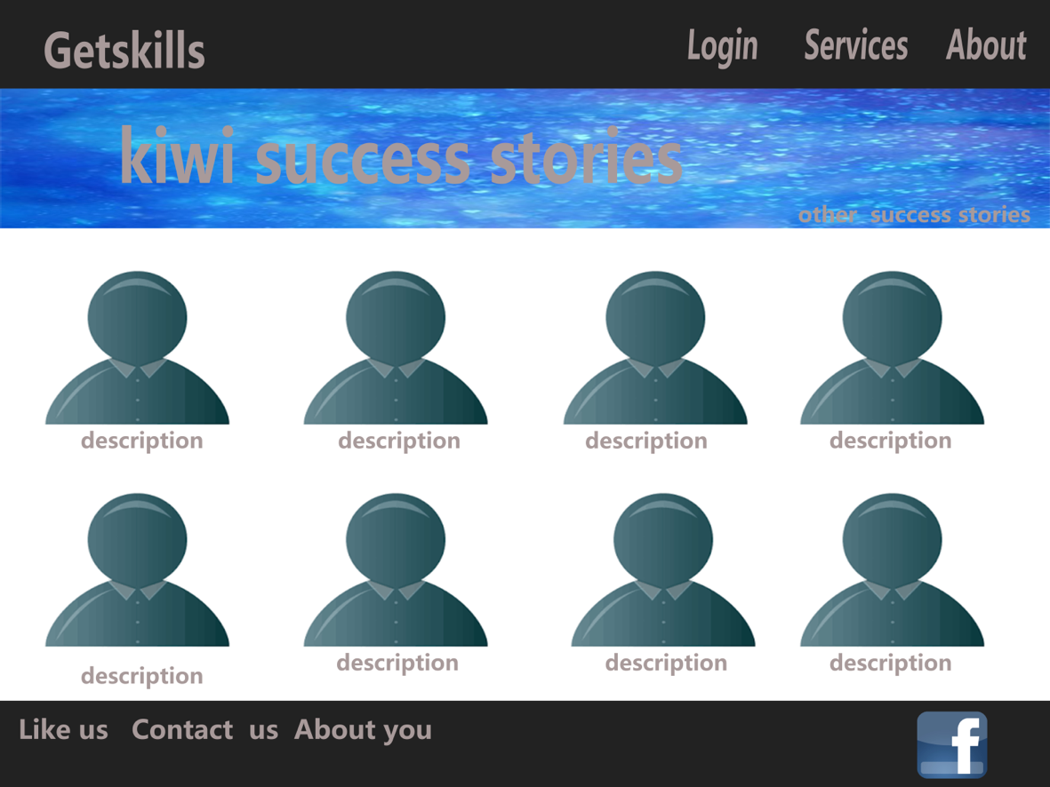
Successful Stories -list view desktop

Slide 14
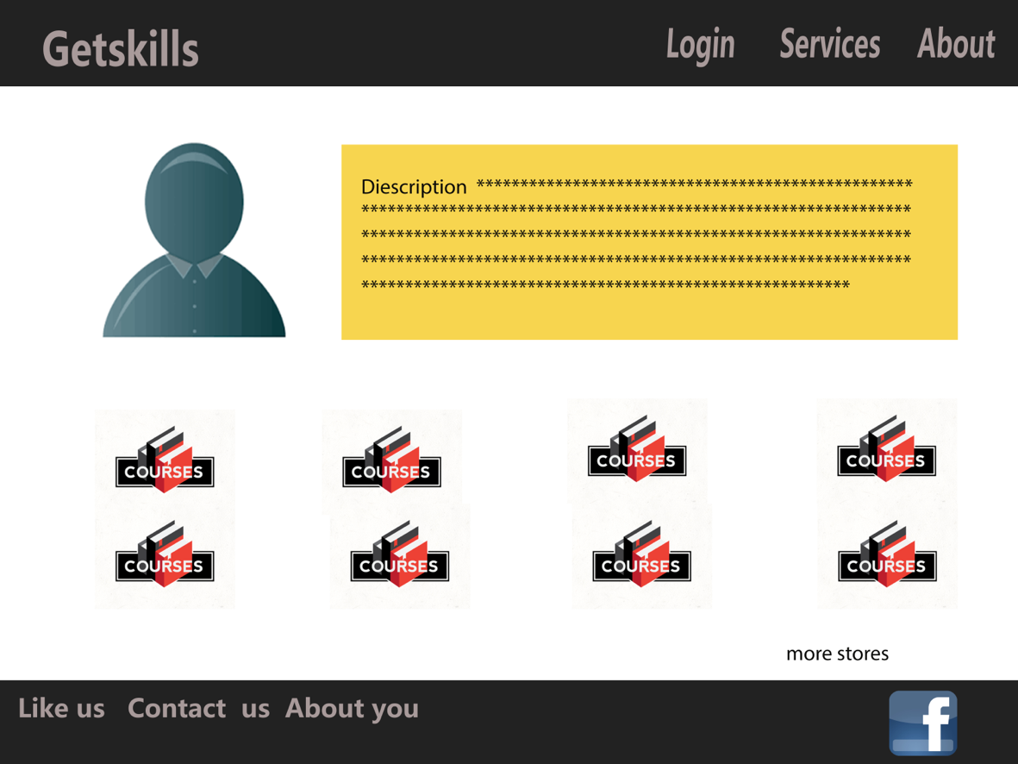
Successful Stories -detail view desktop

Slide 15
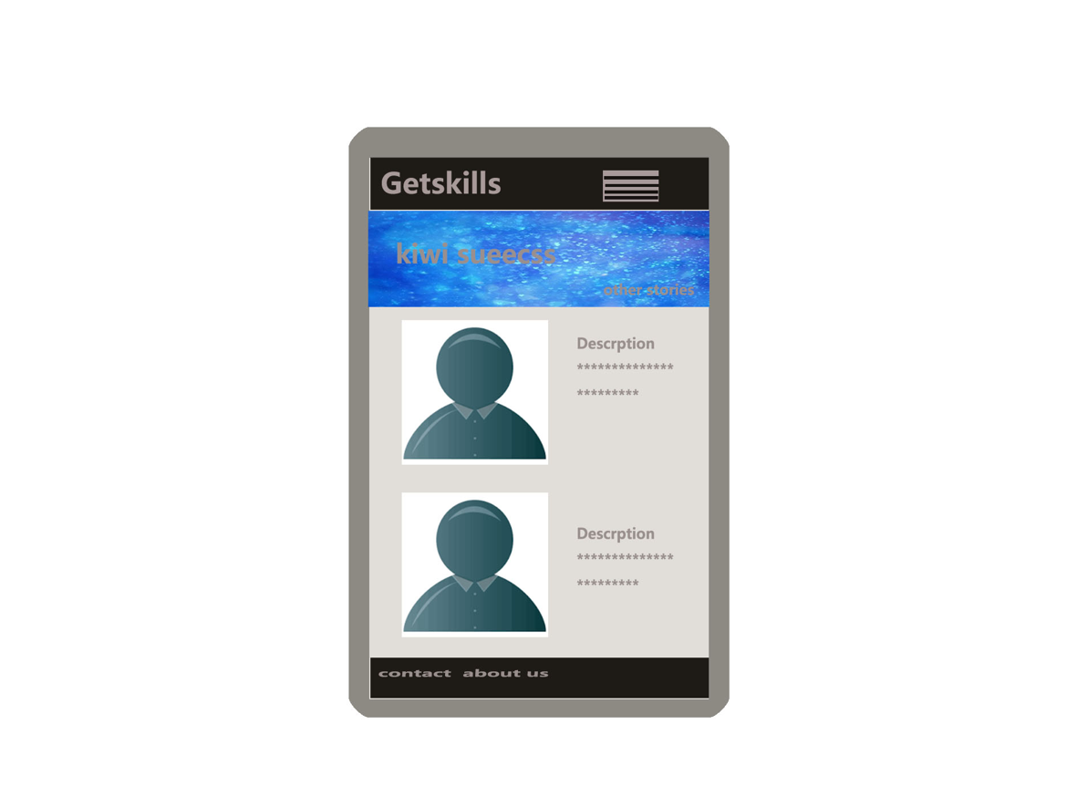
Successful Stories -list view mobile

Slide 16
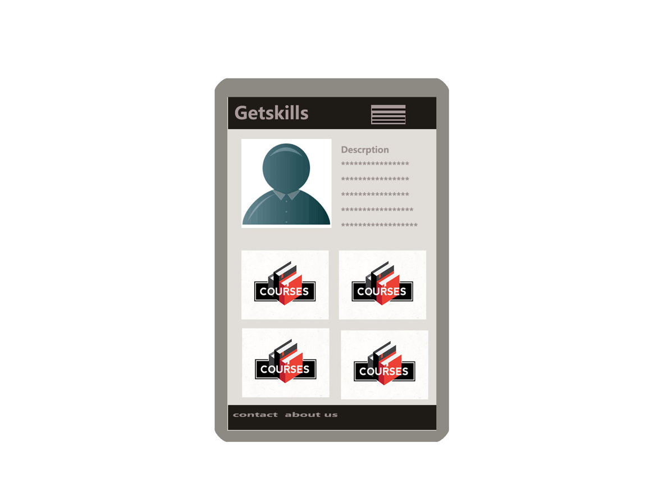
Successful Stories -detail view mobile

Slide 17
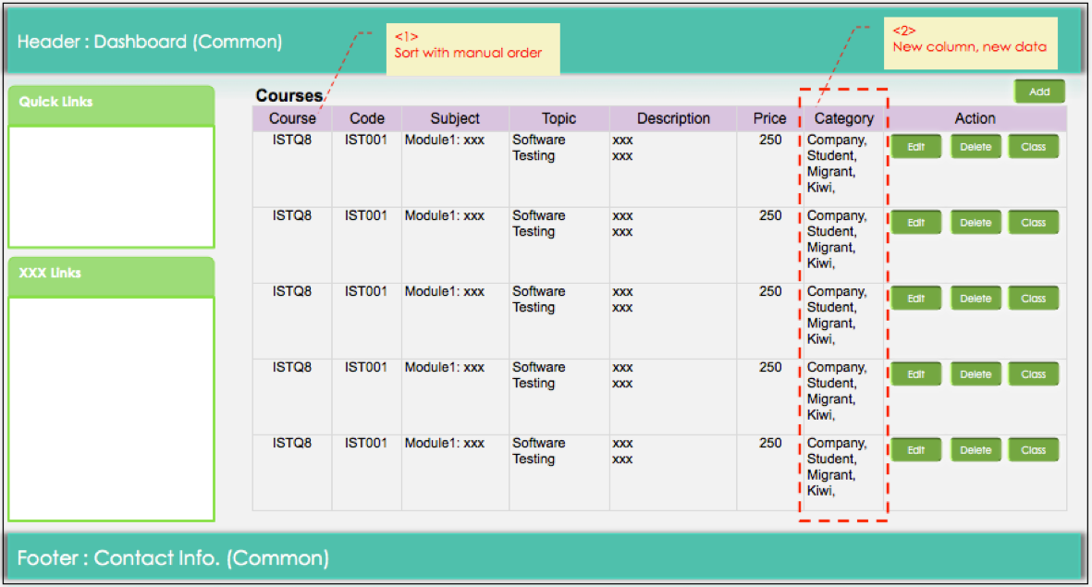
Admin -courses

Slide 18
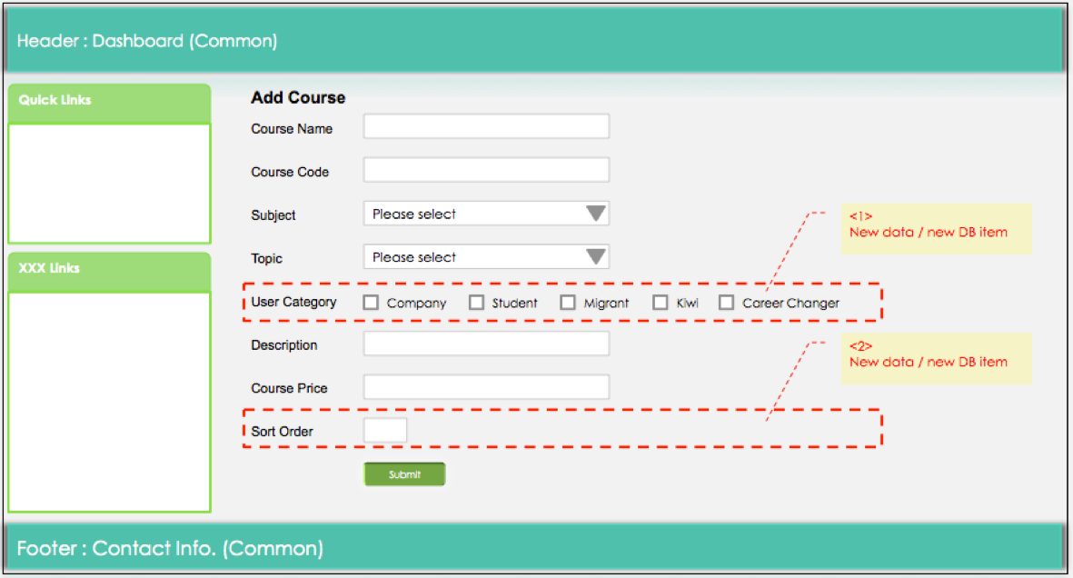
Admin -add course

Slide 19
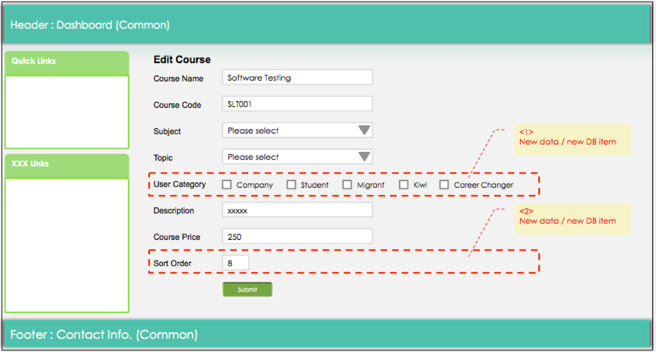
Admin -edit course

Slide 20
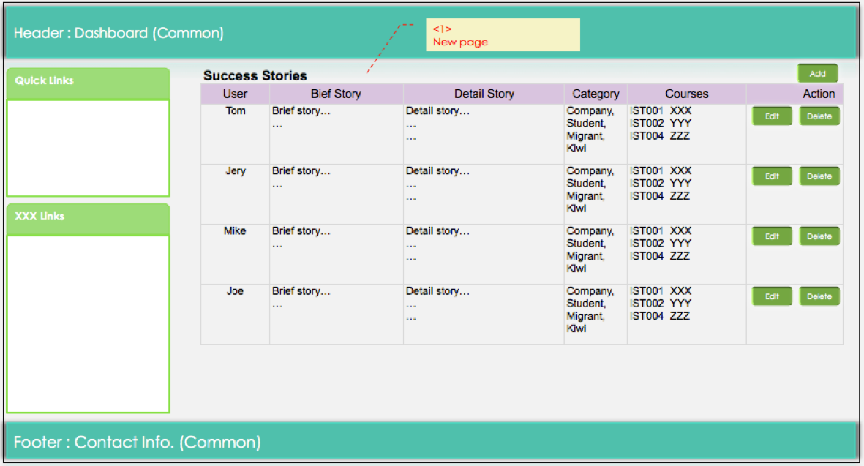
Admin -successful stories

Slide 21
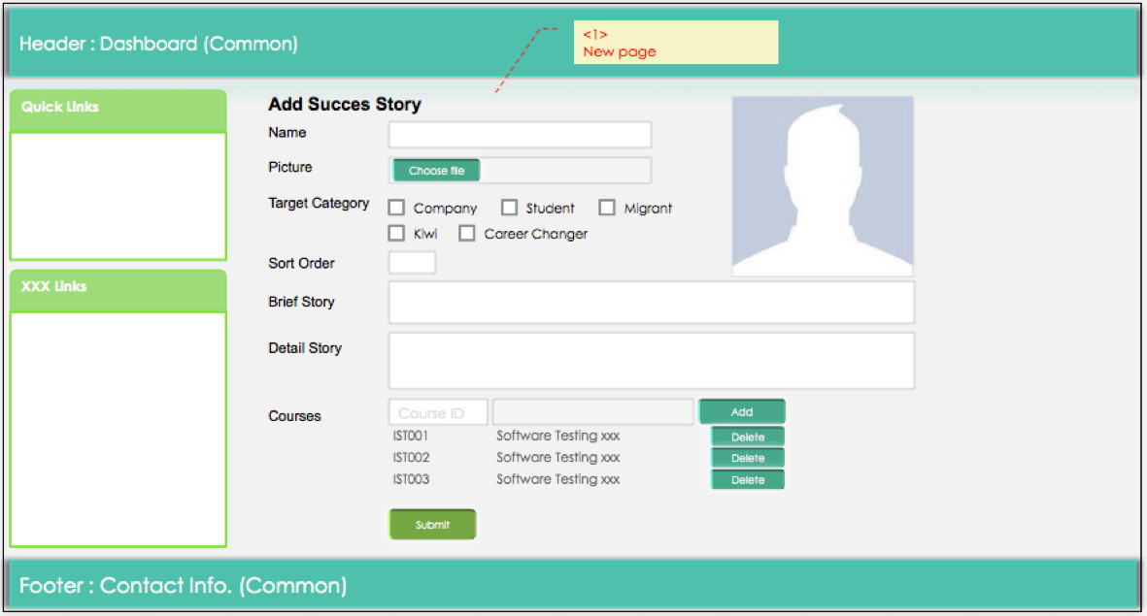
Admin -add stories

Slide 22
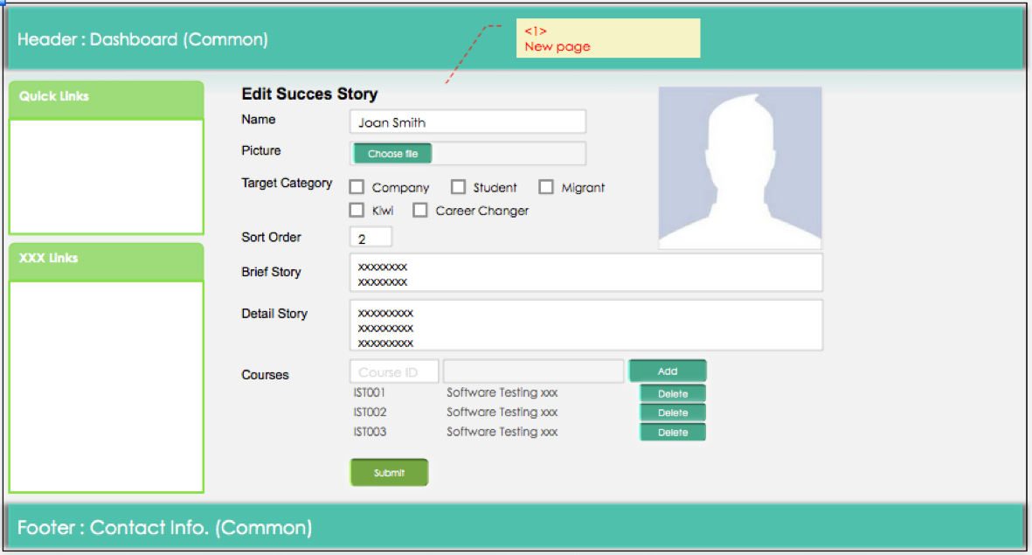
Admin -edit story

